Slide 1



Models development
for audio evaluation in affective computing
29/06/2023
Mário Francisco Costa Silva
Master in Informatics Engineering
Department of Electronics, Telecommunications and Informatics

Slide 2

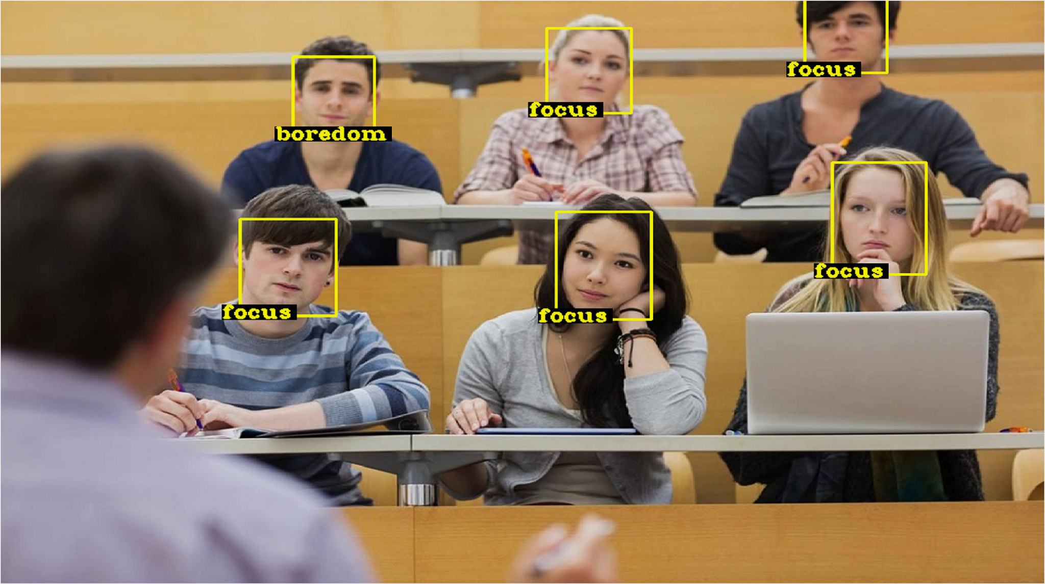
Just like we can understand speech and machines can communicate in speech, we also understand and communicate with humor and other kinds of emotions. And machines that can speak the language of emotions are going to have better, more effective interactions with us.
- MIT Sloan professor Erik Brynjolfsson
Notes:
A minha dissertação insere-se na area da computação afetiva, que tenta fazer com que um computar reconheça emocoes humanas e responda adequadamente.Uma quote de um professor do MIT salienta que um computador capaz disto, vai ter uma comunicação melhor.
Esta deteção de emoções é bastante útil em contextos de video conferencias, por exemplo, em aulas de ensino online, pode ajudar a um professor a adaptar a sua aula, em call centers, ajuda a detectar possiveis problemas de uma chamada, e avaliar a satisfação de um cliente e a sua evolução de estado emocional.

Slide 3
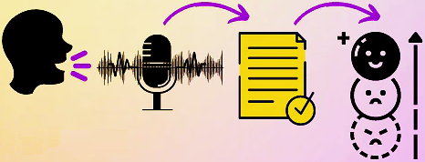
Objectives
Develop a Speech Emotion Recognition (SER) system.
Develop a unique set of audio features and propose different SER models.
Provide an offline and in real-time emotional evaluation.
Notes:
Portanto, temos como objetivos desenvolver um sistema de reconhecimento de emoções através da fala, num contexto de uma video conferencia.
Pretendemos também que seja possível realizar a deteção de emocções tanto em tempo real como depois da conferência terminar.
E apesar de focarmos na fala, iremos também explorar de que forma outras modalidades como expressões faciais podem melhorar o sistema.

Slide 4
Speech Emotion Recognition State-Of-The-Art

Slide 5
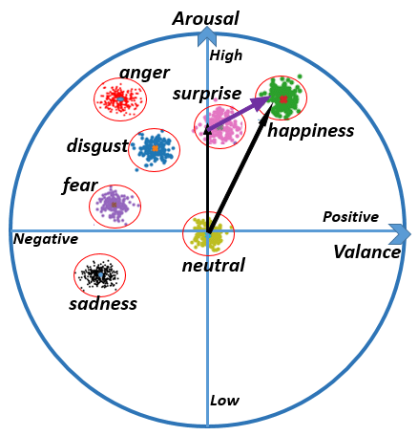
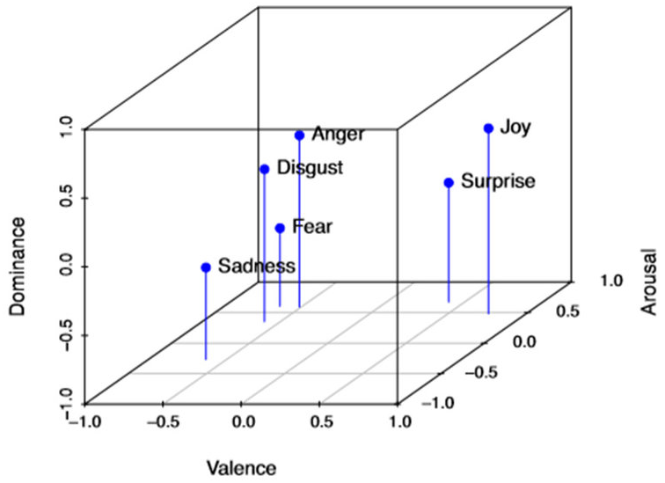
Emotion
There is still no consensus of an accurate representation of the emotion concept due to its natural subjectivity;
However, the most accepted and utilized are the discrete and dimensional models.
Discrete emotions in a 2-D valence-arousal plane.
Discrete emotions in a 3-D valence-arousal-dominance plane.
Notes:
valence (the pleasantness of a stimulus),
arousal (the intensity of emotion provoked by a stimulus),
and dominance (the degree of control exerted by a stimulus).

Slide 6
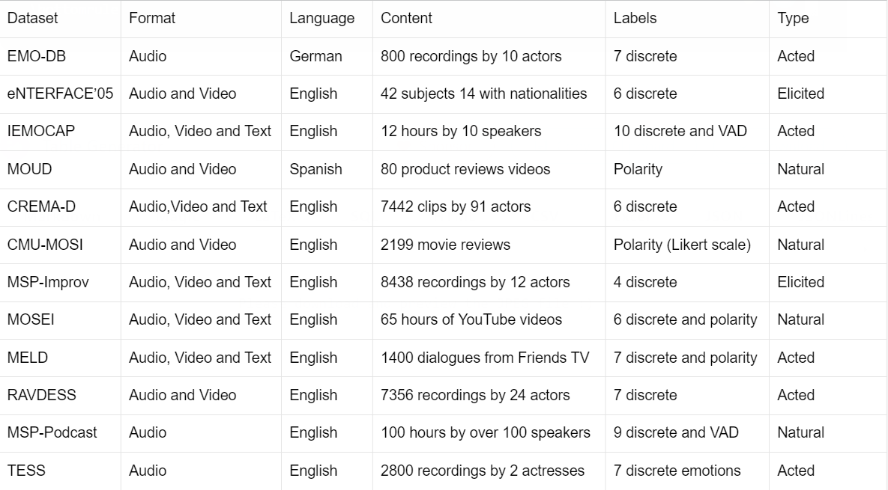
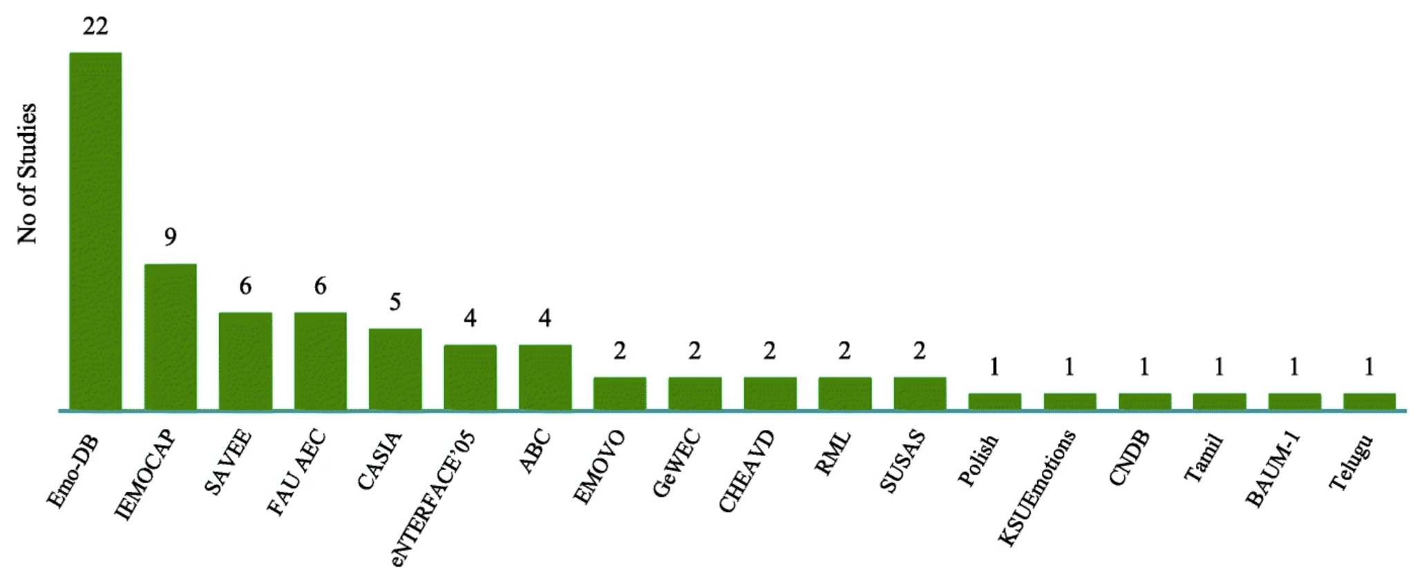
Emotion
Recognition
Datasets
Summary and description of emotion recognition datasets.
Databases used in articles found in SER survey (frequency distribution)

Slide 7
Speech Features
Speech is a vital tool for human communication and social interaction. It is a continuous audio signal that can convey information, emotions and meaning.
Prosodic Features
Can be perceived by humans, such as intonation, rhythm, and loudness.
Energy
Pitch
Duration
Spectral Features
Obtained by transforming the time domain signal into the frequency domain.
Mel-frequency cepstral coefficients (MFCC)
Mel spectrogram
Spectral centroid
Spectral bandwidth
Spectral contrast
Roll-off frequency
Voice Quality Features
Distinctive characteristics of a person's voice and measure of the overall voice quality.
Jitter
Shimmer
Harmonics-to-noise ratio

Slide 8
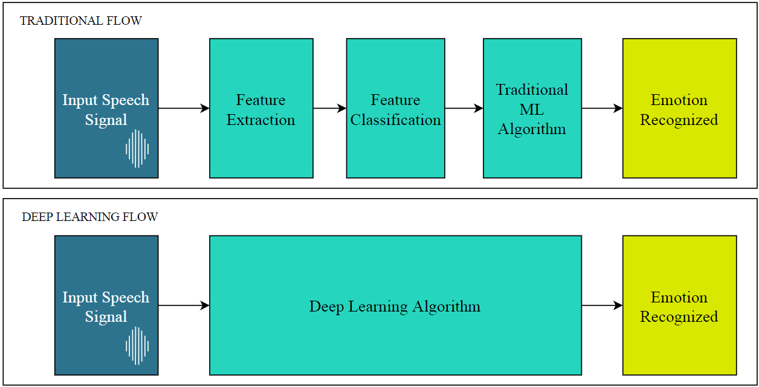
SER Strategies
Traditional Feature-Based
SER Flow
Deep Learning-Based
SER Flow

Slide 9
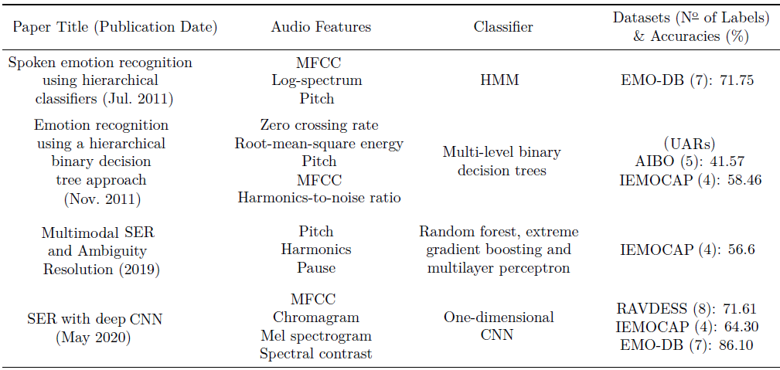
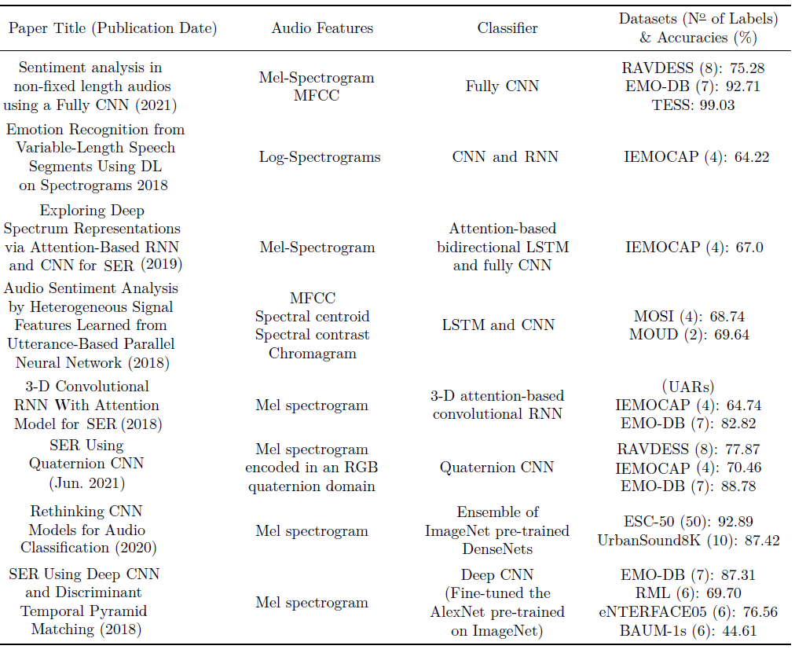
SER SOTA Articles
Audio classification articles with traditional feature-based approaches
SER classification articles with deep learning-based approaches

Slide 10
Key Takeaways
Emotion recognition systems face challenges due to the subjective nature of emotions, lack of consensus on labeling, and the need for diverse emotional data.
Audio feature engineering is crucial for the traditional feature-based SER, requiring focus on feature selection of a wide range of features, including prosodic, spectral, and voice quality.
Deep Learning models, such as CNN, RNN, and LSTM, have outperformed the traditional approach, using Mel spectrogram as input.
Affective computing has shifted towards leveraging multimodal information, beyond facial cues, leading to improved emotion recognition accuracy in current market solutions.

Slide 11
Ethical Considerations
CONCERN | PROCEDURES
System may not be accurate in recognizing emotions for people with certain characteristics (age, gender, accents, speech disabilities, races, etc.). | It was addressed and quantified potential biases present in our proposed models.
System may be used to monitor or control participants without their consent. | Our models require participants consent to submit their data for emotional evaluation purposes.
Personal data collected being vulnerable to hacks or used for unintended purposes. | The SER pipelines only utilize the participant’s streaming data for the models input. They do not store or use sensitive data for any other purposes than emotional analysis.
Revealing or identifying confidential data such as personal, financial, or business information. | The models do not include speech transcriptions, and therefore, do not capture the actual words spoken.

Slide 12
Speech Emotion Recognition Development

Slide 13
SER Development Methodology
3. Traditional Feature-Based SER
1. Datasets Selection
5. Data Stratification
2. Audio Preprocessing
6. SER Pipeline
4. Deep Learning-Based SER

Slide 14
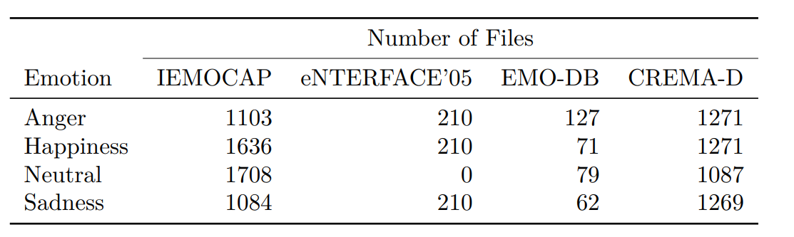
1. Datasets Selection
The IEMOCAP dataset was utilized as the main dataset, which is for feature engineering, models evaluation and selection, and as training data for the final proposed models. For cross-dataset validation of these models, we selected three additional datasets: eNTERFACE’05, CREMA-D, and EMO-DB.
Number of audio files per emotion from the selected datasets.

Slide 15
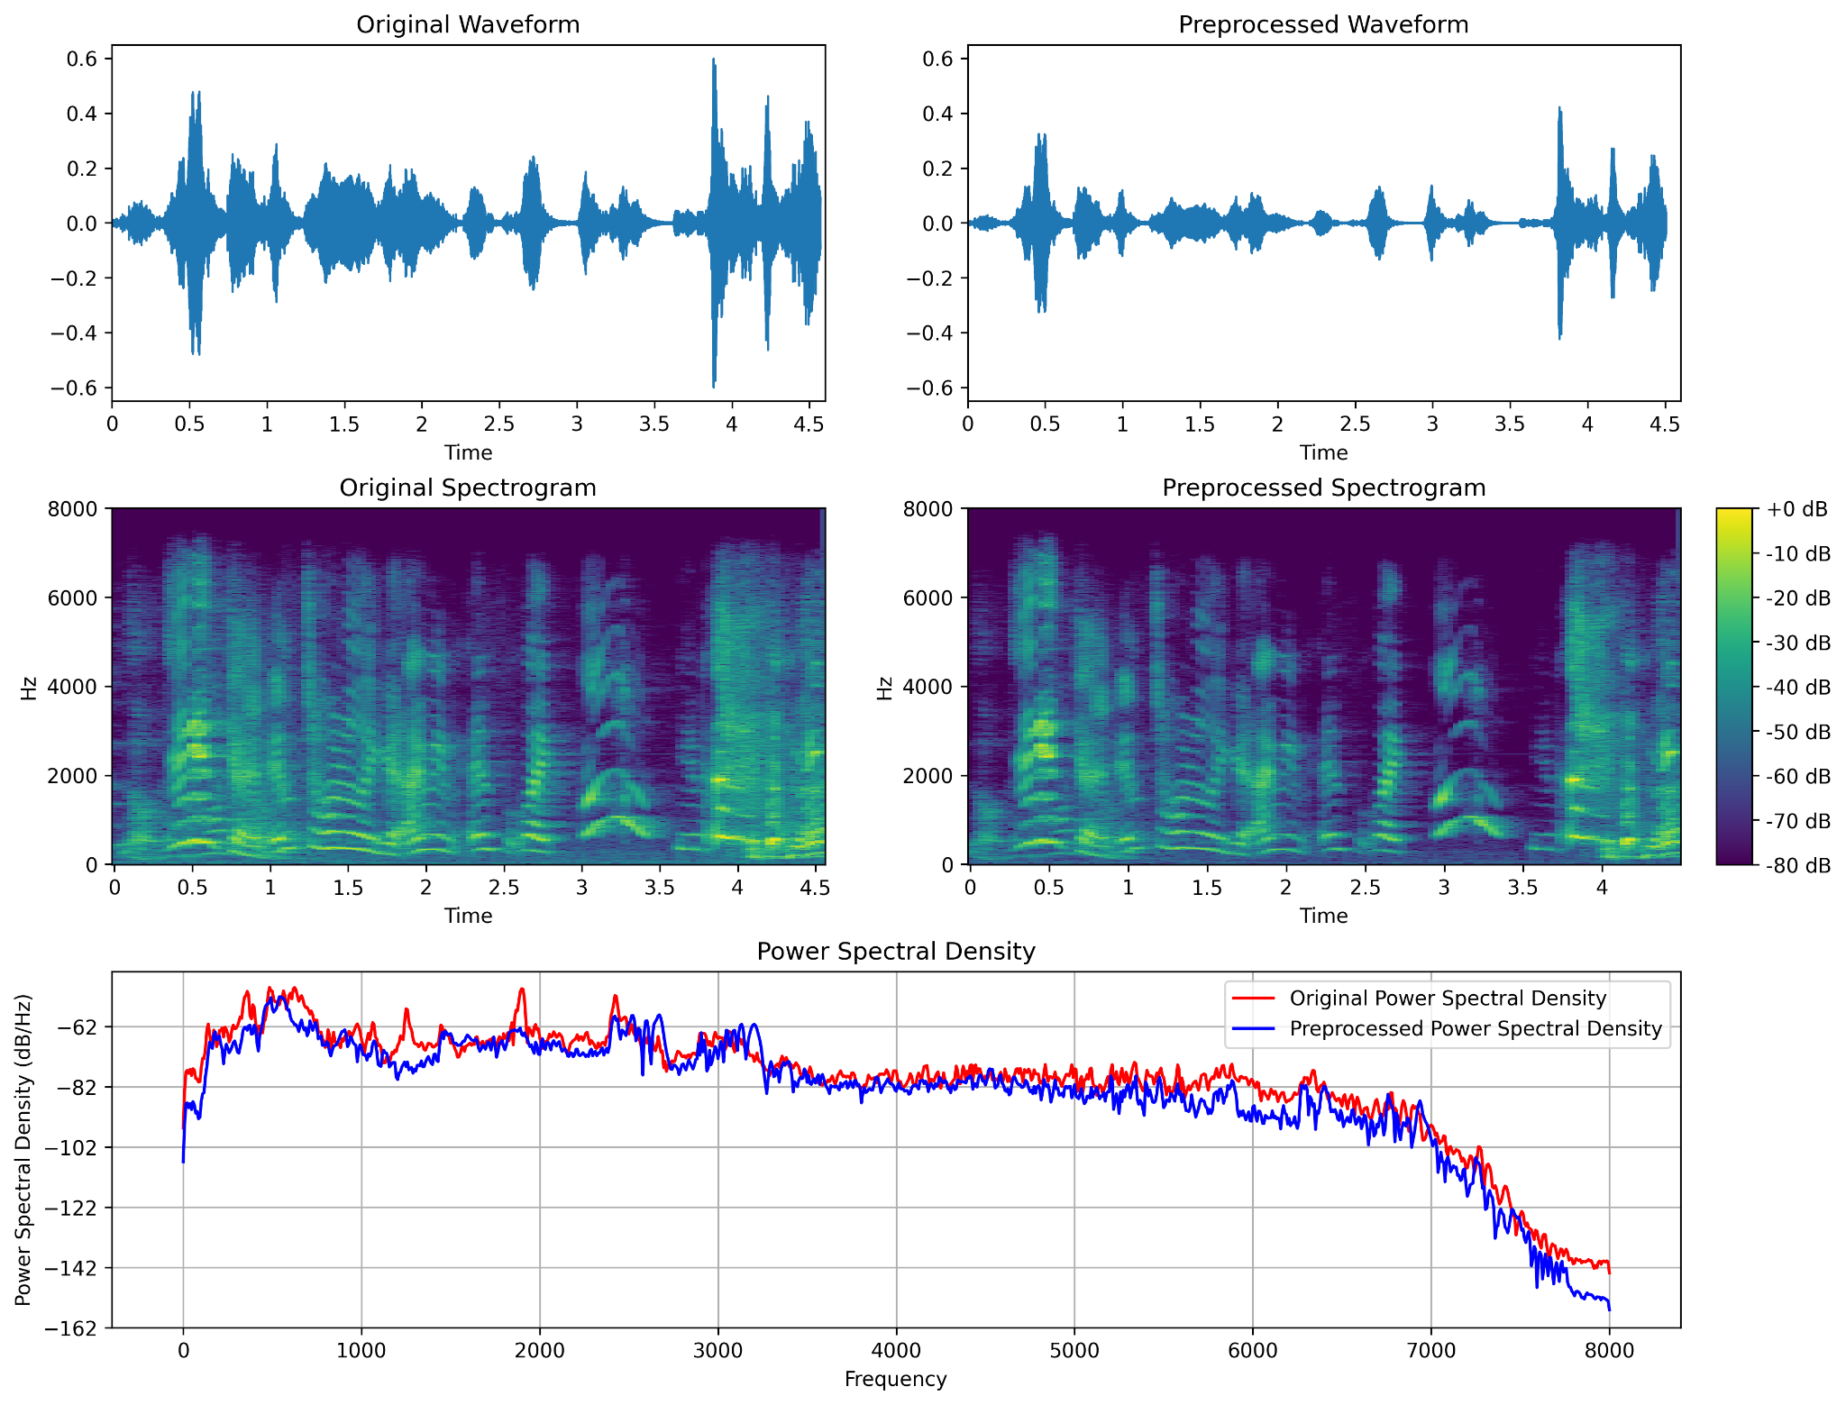
2. Audio Preprocessing
Noise reduction, using the spectral gating technique.
Audio trimming, which removes silent frames at the beginning and end of an audio signal.
Graphics of audio features before and after preprocessing.

Slide 16
3. Traditional Feature-Based SER

Slide 17
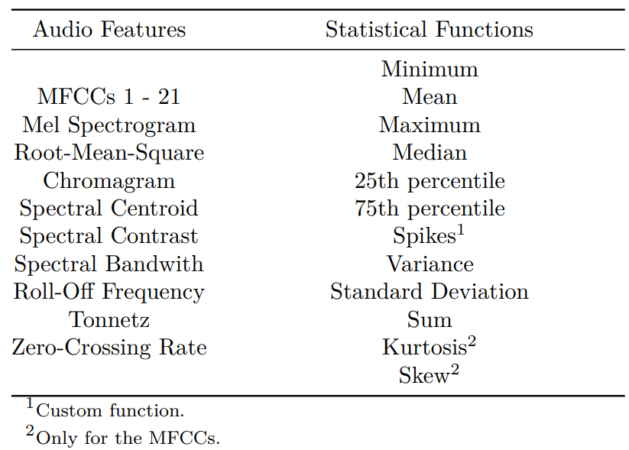
3.1. Feature Extraction
Extracted audio features and the applied statistical functions.

Slide 18
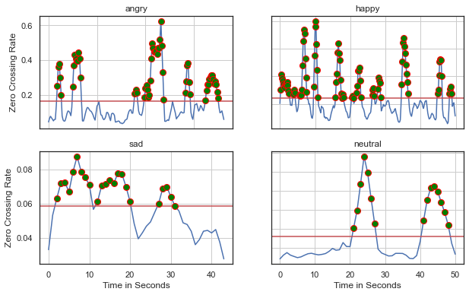
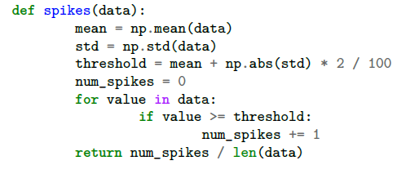
3.2. Feature Analysis
Wave Plots and the “Spikes” Metric
Python code for calculating the spikes metric:
Zero crossing rate wave plot annotated with spikes.

Slide 19
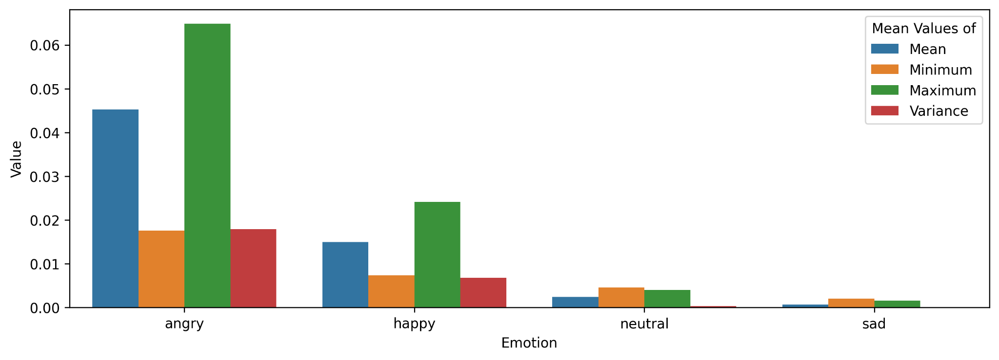
3.2. Feature Analysis
Bar Plots
Bar plots mean for metrics used on the mel spectrogram feature.

Slide 20
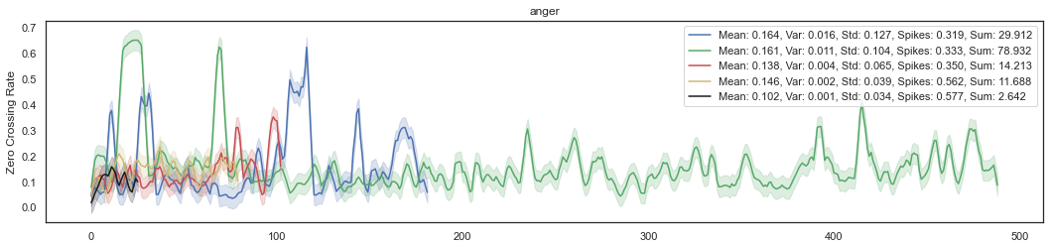
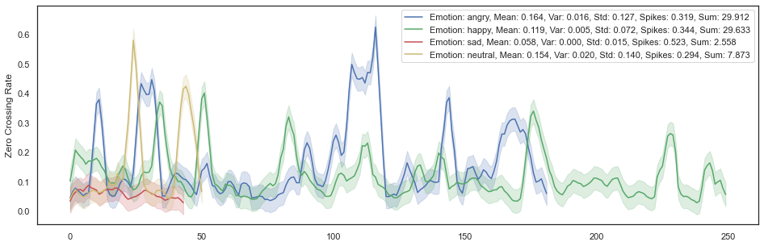
3.2. Feature Analysis
Wave Plots with Surrounding Areas
Zero crossing rate wave plots with a surrounding area of five male subjects for the same utterance with the anger emotion.
Zero crossing rate wave plots with a surrounding area of a single male subject and sentence for
all different emotions.

Slide 21
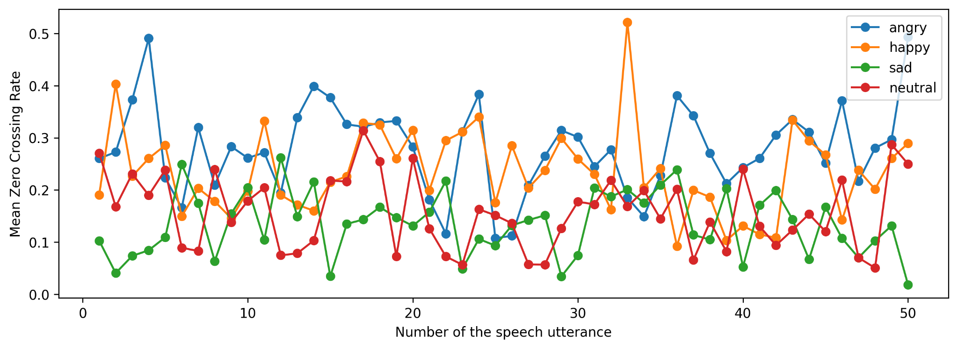
3.2. Feature Analysis
Variation Plots
Zero crossing rate mean values variation plot along 50 audios of speech utterances for all emotions.

Slide 22
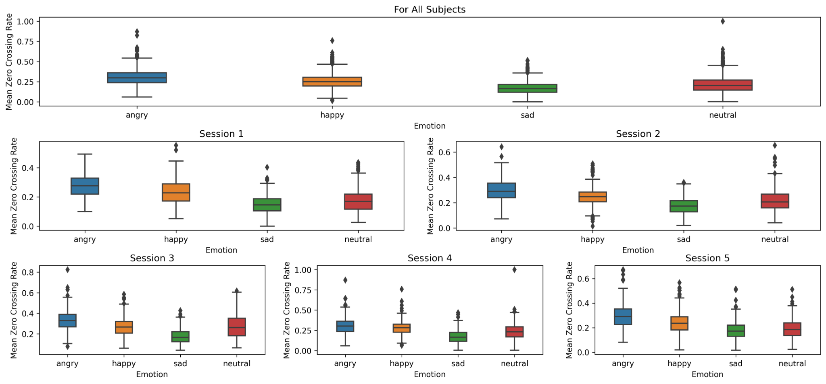
3.2. Feature Analysis
Box Plots
Zero crossing rate mean values box plot for all emotions and different subjects.

Slide 23
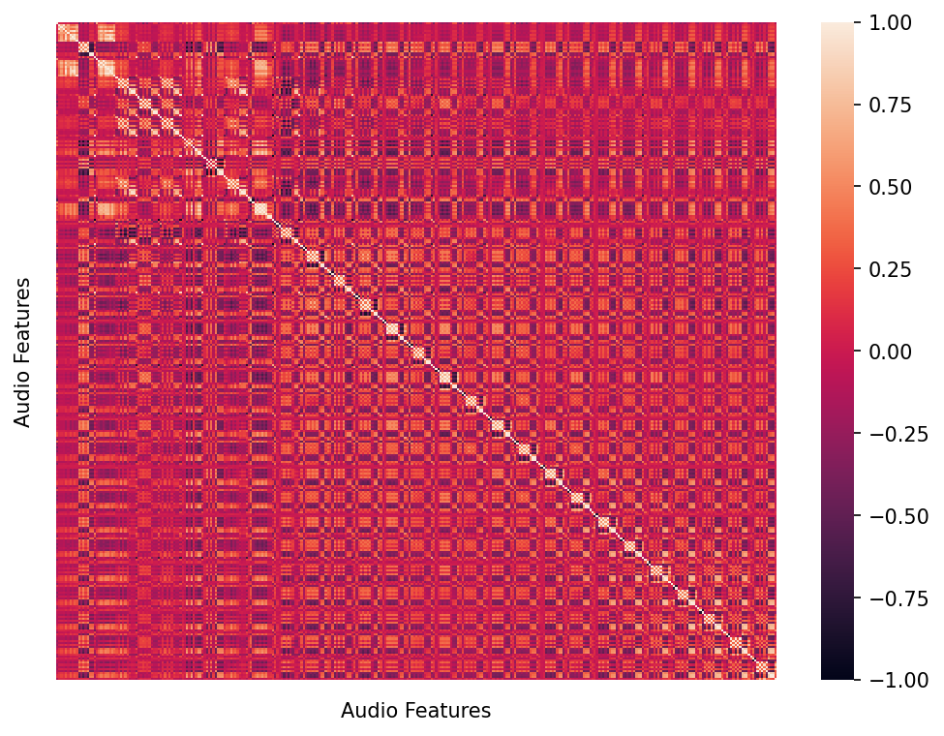
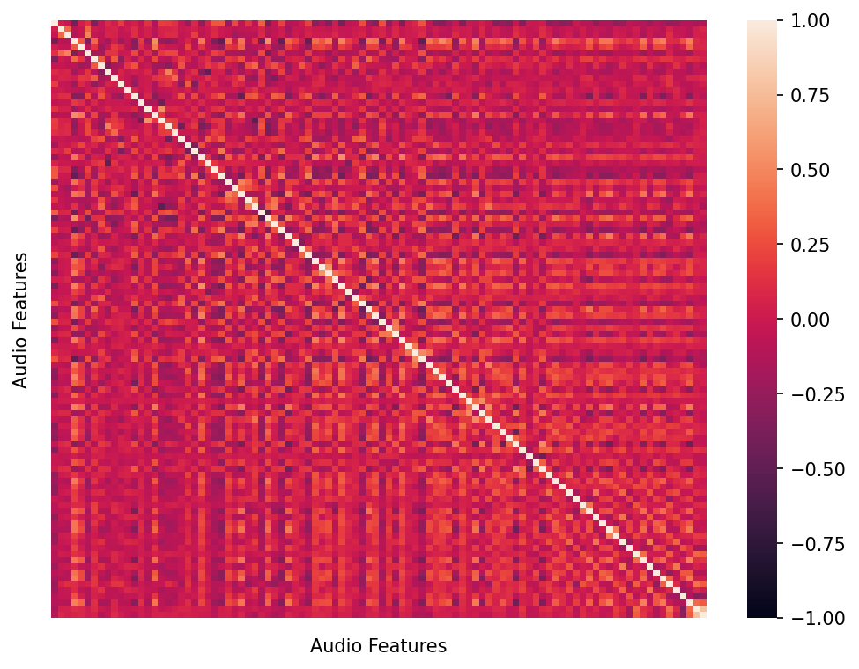
3.3. Feature Selection
Correlation-Based Feature Selection (CFS)
Correlation matrix of all the audio features.
Correlation matrix of the selected audio features after CFS.

Slide 24
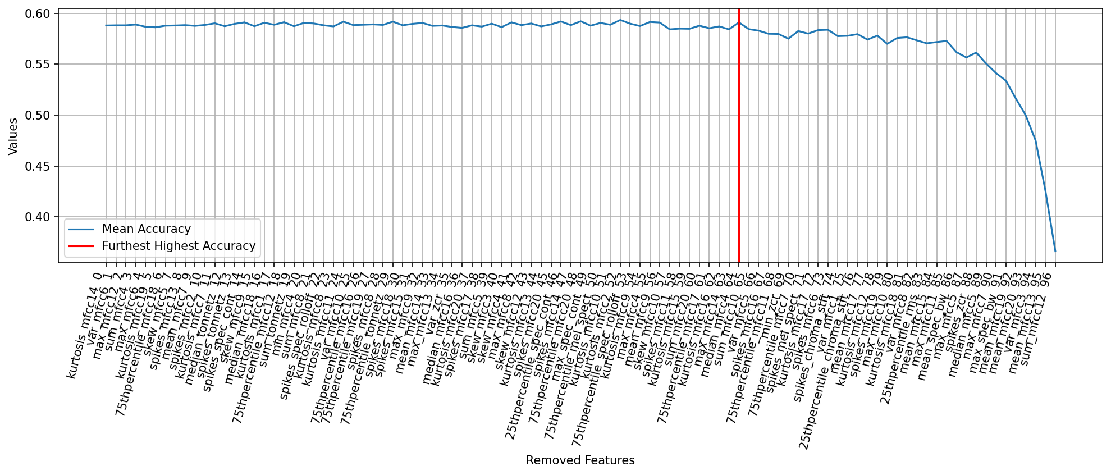
3.3. Feature Selection
Backwards Selection
Backwards Selection using the mean accuracy as the selection criteria.

Slide 25
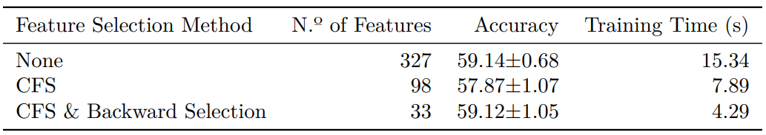
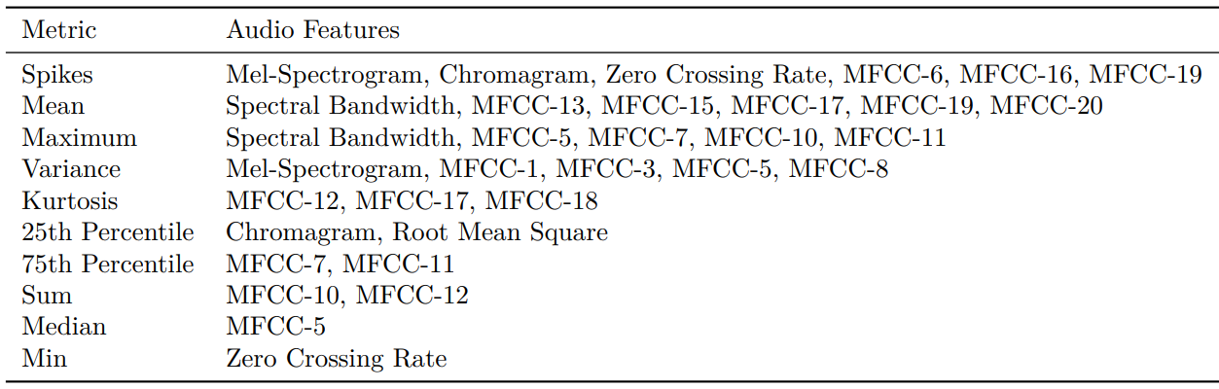
3.3. Feature Selection
Random Forest 5-fold cross-validation results using different sets of features.
Final set of the 33 selected features.

Slide 26
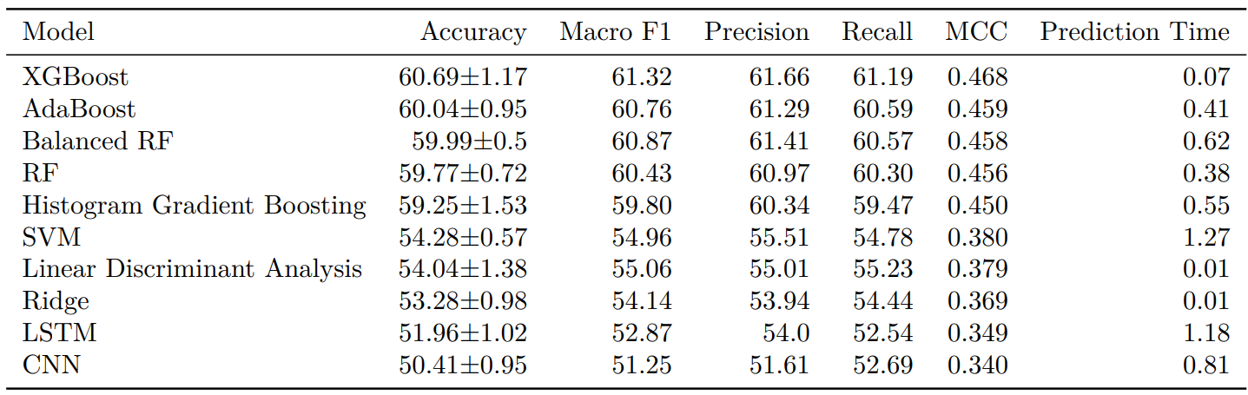
3.4. Classifiers Evaluation and Results
Sampling Technique: 5-Fold Stratified Cross-Validation
Metrics: Accuracy, Recall, Precision, Macro-F1 Score, Matthews Correlation Coefficient
Tested traditional models’ evaluation results on IEMOCAP.

Slide 27
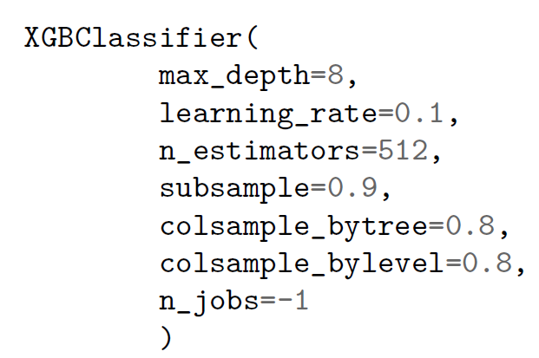
3.5. Proposed Classifier
eXtreme Gradient Boosting (XGBoost)
XGBoost is a renowned and highly accurate model that uses gradient-boosted decision tree ensembles. It effectively mitigates overfitting by employing a combination of L1 and L2 regularization techniques. The model sequentially builds decision trees using boosting, where each subsequent tree corrects errors made by the previous one, with a focus on addressing misclassified data points.
Overall, XGBoost is a versatile and powerful algorithm that provides several advantages:
Speed
Performance
Scalability
Handling of Missing Valus
Regularization
Interpretability
Python code for the proposed XGBoost (XGBoost Library):

Slide 28
4. Deep Learning-Based SER

Slide 29
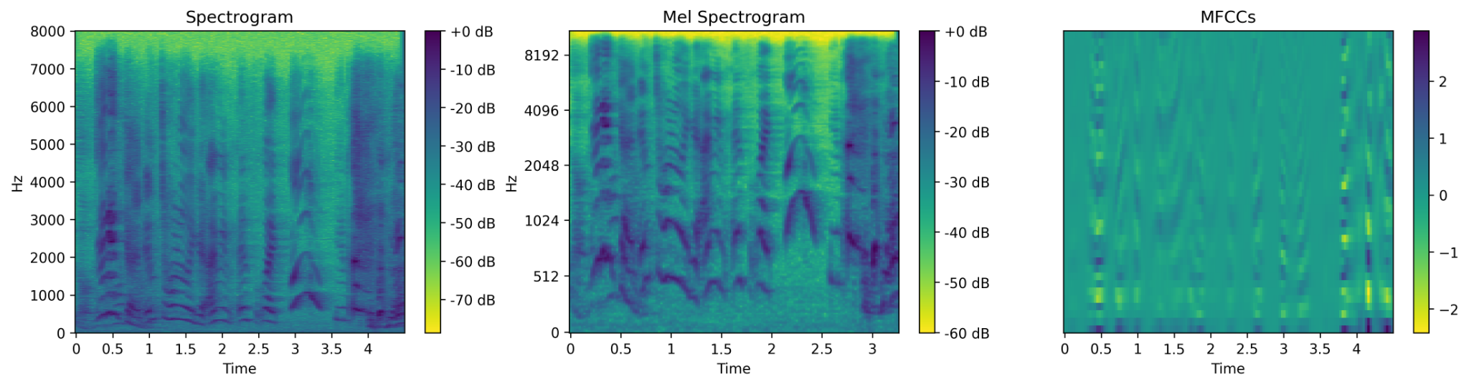
4.1. Deep Learning Features
Features Dimensions:
For the 2D Models (Numeric Matrices): 1025x188 - Spectrogram, 256x188 - Mel Spectrogram, 40x188 - MFCC
For the 3D Models (PNGs): 224x224x3 - All Features
Graphical representations of the selected deep learning features.

Slide 30
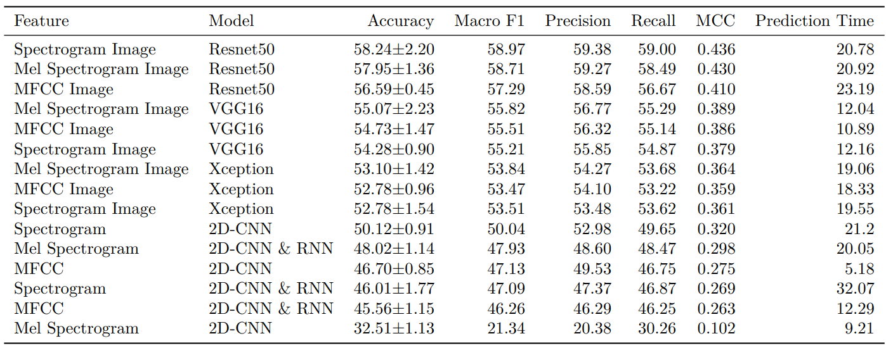
4.2. Classifiers Evaluation and Results
Sampling Technique: 5-Fold Stratified Cross-Validation
Metrics: Accuracy, Recall, Precision, Macro-F1 Score, Matthews Correlation Coefficient
Tested deep learning models’ evaluation results on IEMOCAP.

Slide 31
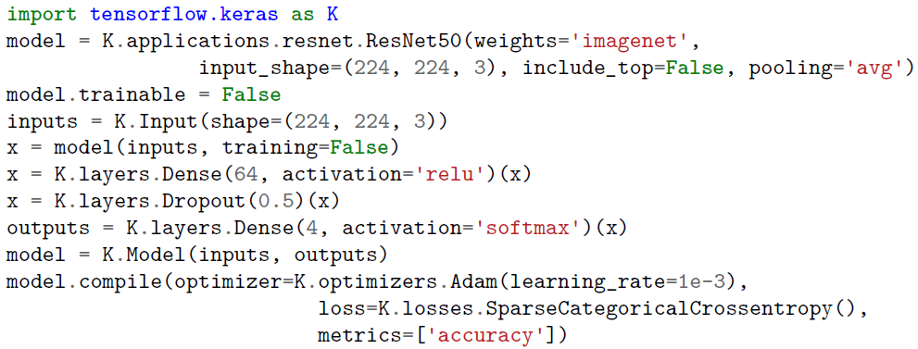
4.3. Proposed Classifier
ResNet50 using 3D Spectrogram Images
ResNet50, pre-trained on ImageNet, is a powerful deep neural network model with 50 convolutional layers, and with skip connections to enable the direct flow of information between layers, capturing complex representations of the input data.
Some advantages of ResNet50 are:
Addresses the vanishing gradient problem with residual connections;
Facilitates transfer learning with pre-trained models;
Fast training for large-scale datasets;
High accuracy in various image classification tasks.
Python code for the proposed Resnet50 (TensorFlow):

Slide 32
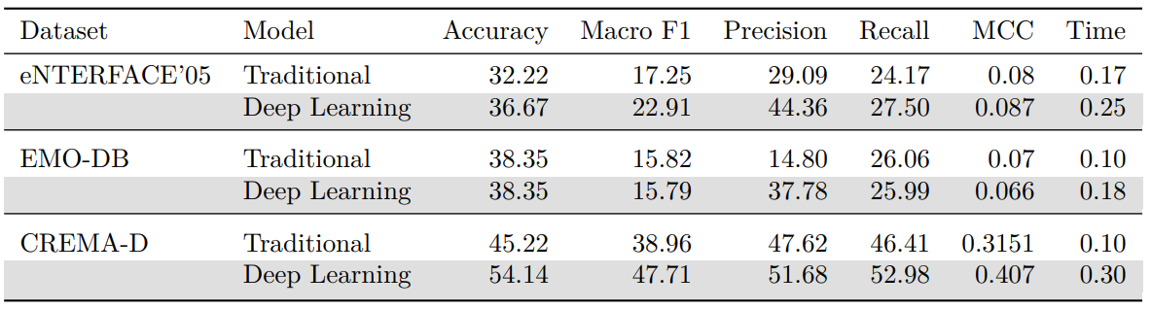
SER Proposed Models
Cross-Dataset Validation
Proposed models trained on IEMOCAP and evaluated on different datasets.

Slide 33
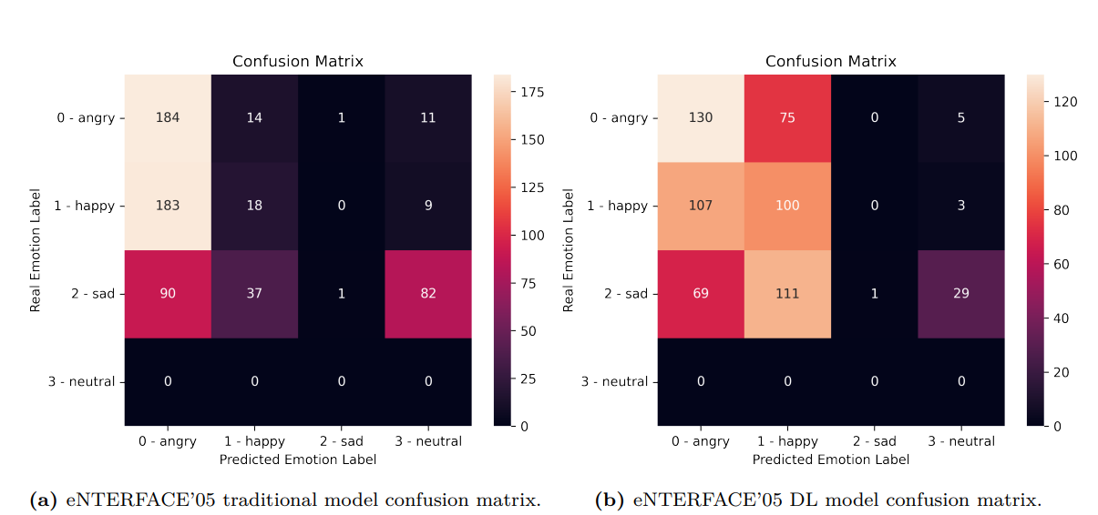
SER Proposed Models
Cross-Dataset Validation

Slide 34
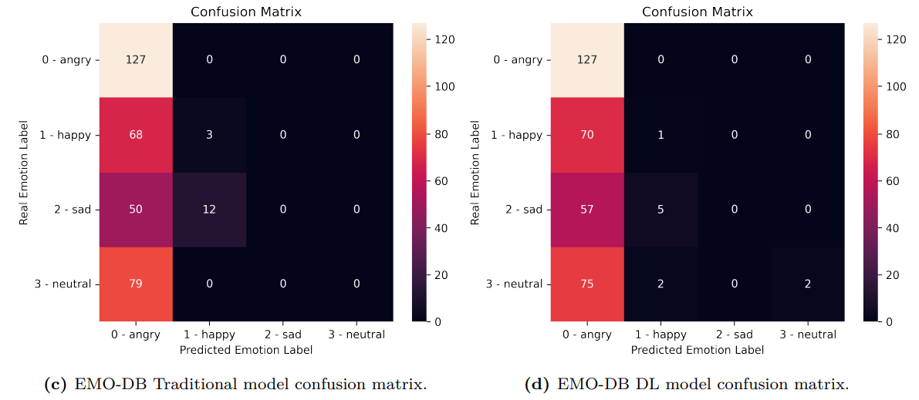
SER Proposed Models
Cross-Dataset Validation

Slide 35
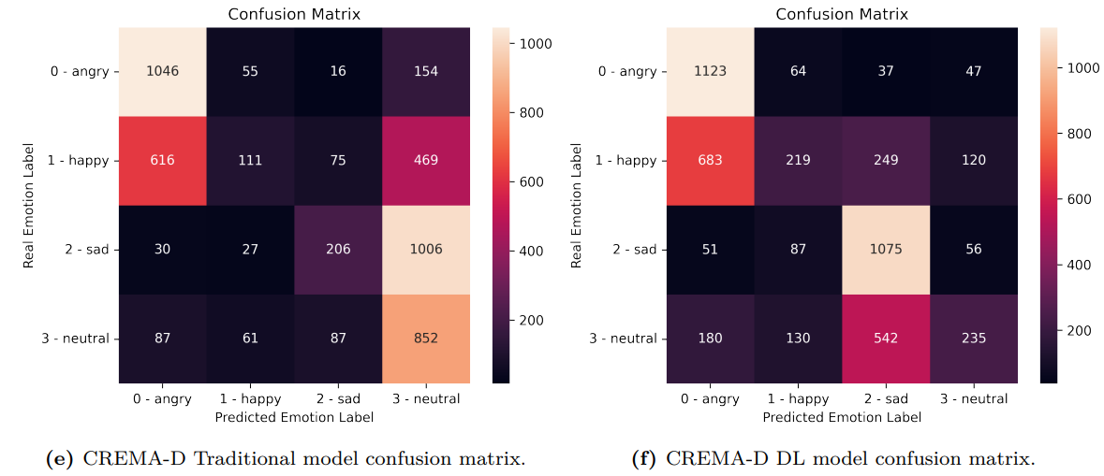
SER Proposed Models
Cross-Dataset Validation

Slide 36
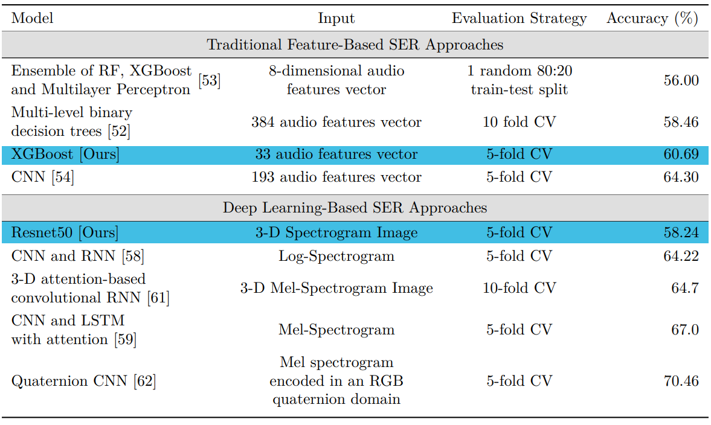
SER Proposed Models
SOTA Comparison
SOTA SER classification models performance on IEMOCAP.

Slide 37
5. Data Stratification

Slide 38
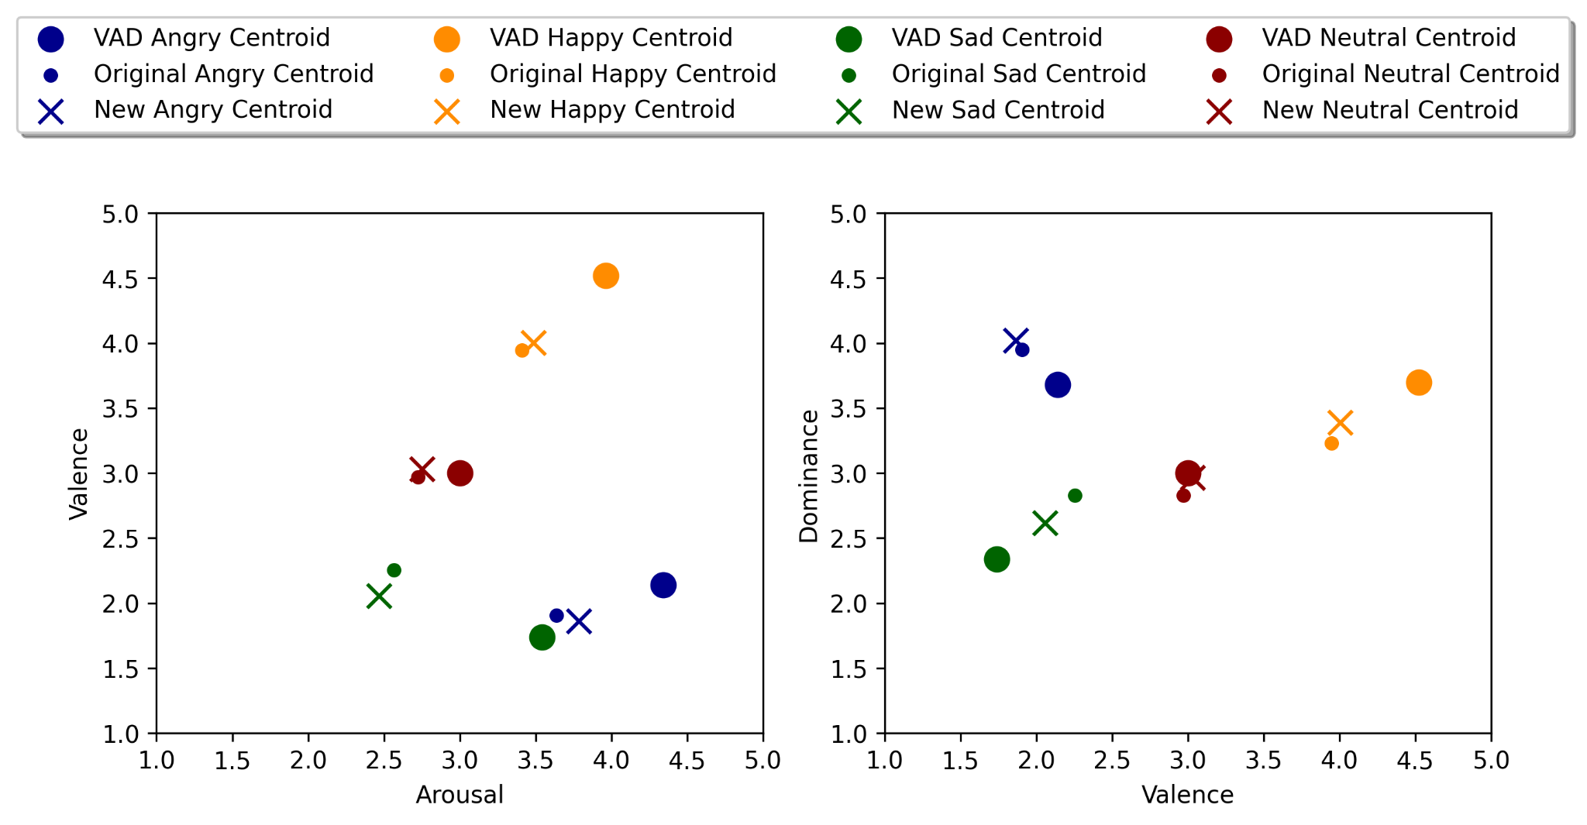
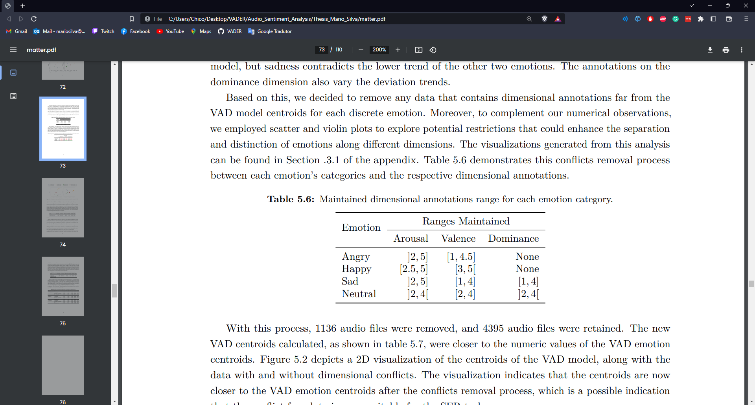
To uncover the shortcomings and biases of the dataset and the proposed models, data was stratified based on: recordings duration, speaker gender, discrete and dimensional labels.
As a result of this process, a set of conditions was applied on the dataset, including a minimum duration of 1 second, and dimensional annotations must be within a certain range in relation to the discrete emotion. The resulting “stratified” data contained a total of 4200 audio files, with a nearly gender balanced distribution.
Maintained dimensional annotations range for each emotion category.

Slide 39
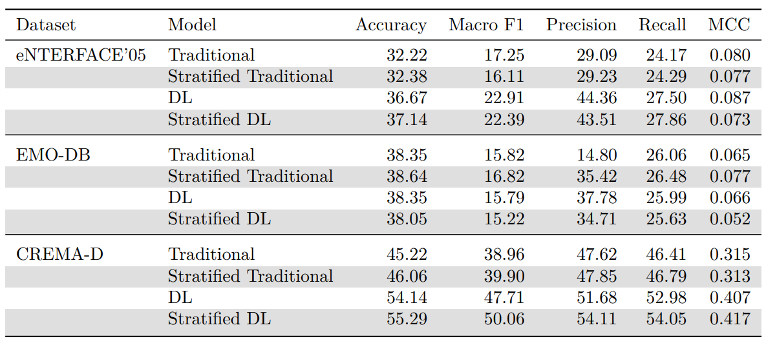
5.1. Validation
Proposed models trained on the entire and stratified IEMOCAP and evaluated on different datasets.

Slide 40
6. SER Pipeline

Slide 41
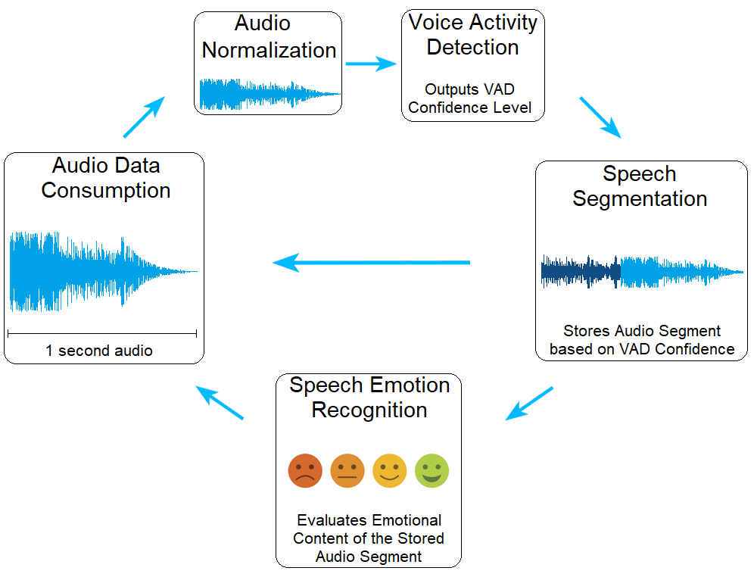
Architecture

Slide 42
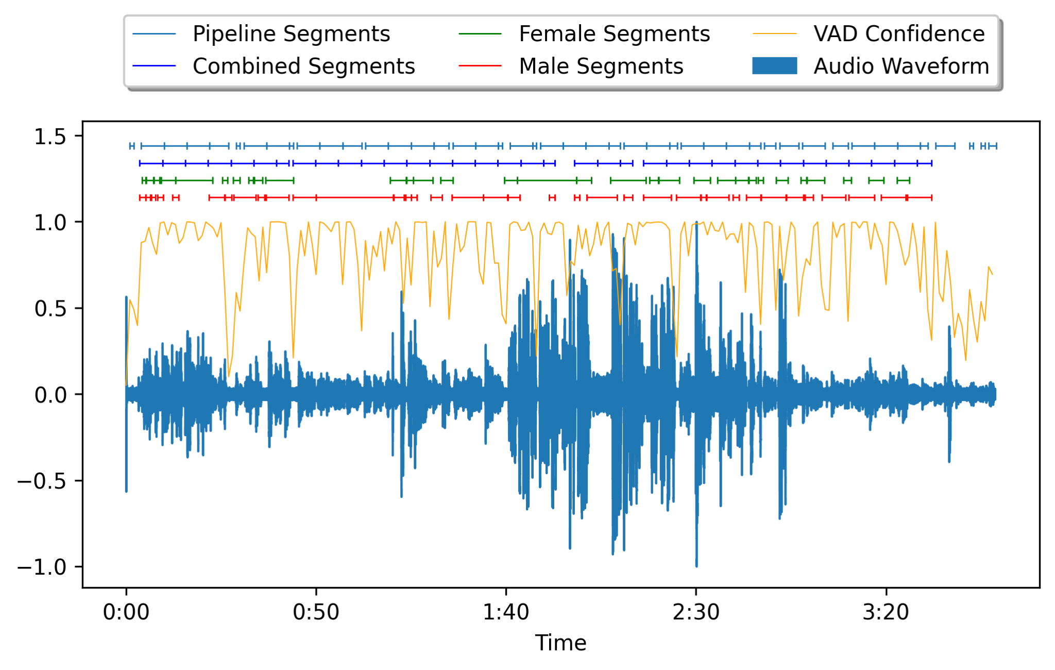
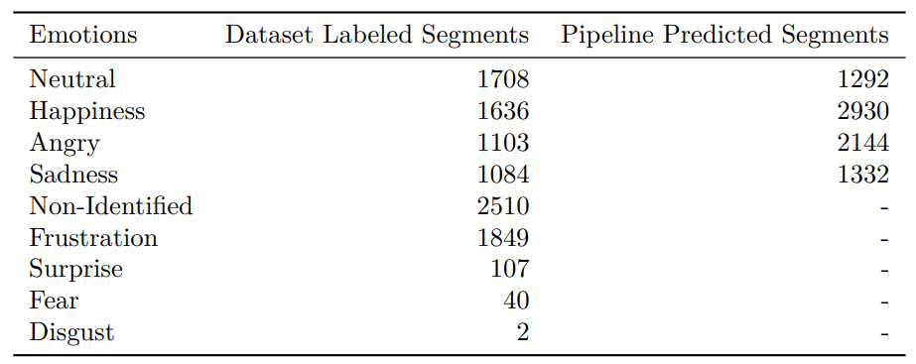
Pipeline Validation
Annotated emotions of the entire IEMOCAP dataset and the pipeline’s predicted segments.
A session from IEMOCAP segments and the pipeline’s detected segments.

Slide 43
Conclusion
XGBoost and ResNet50 models that have a competitive performance and potential for real-world application;
Small set of hand-crafted features (33) that achieves high results in comparison to the SOTA.
Application of transfer-learning techniques for image recognition in the SER area.
Identification of high-quality data and biases through data stratification processes;
SER pipeline for efficient detection and construction of speech segments;
Future work: Fine-tuning models, exploring additional datasets, and leveraging multimodal approaches (speech, facial expressions, text) to enhance emotion recognition accuracy.
Notes:
Em conclusão, com esta investigação conseguimos fazer uma contribuição significativa para o campo SER, sendo os 5 pontos principais:

Slide 44
Models development
for audio evaluation in affective computing
29/06/2023
Mário Francisco Costa Silva
Master in Informatics Engineering
Department of Electronics, Telecommunications and Informatics

